Slide 1
Energy Data Analysis and Reporting using Azure Synapse Analytics and Power BI

Slide 2
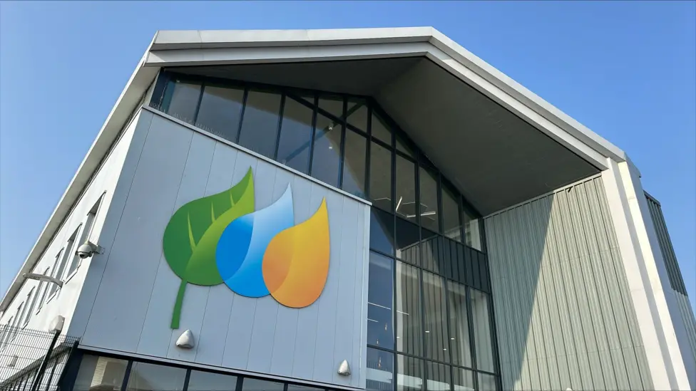
Agenda
Project Overview
Technical Architecture
Data Flow and Process Breakdown
Business Outcomes and Impact
Conclusion

Slide 3

Project Overview
Business Problem – Analyze and report energy usage trends for improved decision-making.
Type of Data
Integrate data from multiple sources including Azure SQL Database, IoT Data from ADLS Gen2, and JSON files
Technologies Used
Azure Data Factory
Synapse analytics
Power BI

Slide 4




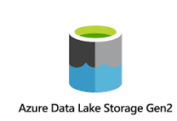

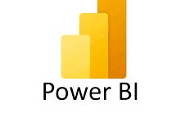
Technical Architecture
Load
Transform
Bronze Layer
Silver Layer and Gold Layer
Integrate

Slide 5
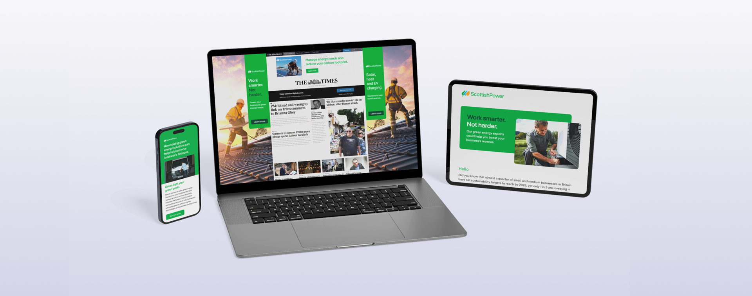




Business Outcomes and Impact
improved Decision-Making
Operational Efficiency
Real-Time Data Access
Scalability and Flexibility

Slide 6
Conclusion
Unified Data Integration:
Integrated data from multiple stakeholders.
Key Achievements:
Improved real-time decision-making.
Increased operational efficiency and automated reporting.
Scalable and flexible solution for future growth.
Impact: Provided actionable insights for business stakeholders and streamlined data processes.
Future Scalability: Designed to adapt to new data sources and evolving business requirements.

